Slide 1
DRAFT
INNER MELBOURNE ACTION PLAN
2015-2025
Presented by Elissa McElroy
IMAP Executive Officer
January 2016

Slide 2
PURPOSE
To present the Draft Inner Melbourne Action Plan 2015-2025 (Draft Plan) for external engagement and comment prior to the preparation of the Final Plan.
Seeking any potential amendments and comments by 29 February 2016.
TIMELINE

Slide 3
GOVERNANCE
Inner Melbourne Action Plan (IMAP) established in 2006
5 Special Committees
Changed governance environment required Plan update:
Inclusion of Maribyrnong Council in IMAP region
- Plan Melbourne (‘Central Subregion’)
Focus on regional actions that deliver agreed regional outcomes
Each stakeholder receives benefits they could not achieve by acting alone
KEY REQUESTS
for Draft Plan from Councillor Workshop
Greater advocacy
Partner with government
Economies of scale, share resources and services, reduce duplication

Slide 4
VISION
Inner Melbourne will continue to improve its internationally-renowned liveability whilst responding to the challenges of rapid growth.
MISSION
The IMAP Implementation Committee and their respective Councils will pursue the following mission to achieve IMAP’s Vision and Goals:

Slide 5
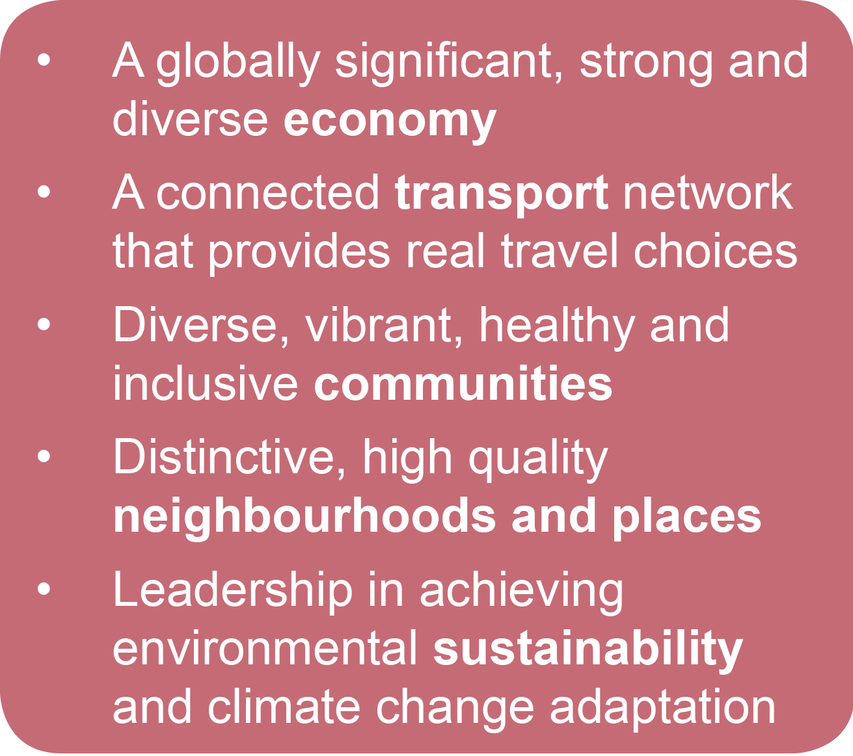
GOALS
OUTCOMES
What Melbourne could look like in 10 years’ time
STRATEGIES
27 Strategies under the 5 Goals:
Detail IMAP Councils’ regional planning, cooperation and joint approach
Identify Opportunities for advocacy, partnerships and efficiencies to guide the Working Groups

Slide 6
GOALS & STRATEGIES
Goal 1: A globally significant, strong and diverse economy
Strategies cover topics :
Foster growth in knowledge economy & creative industry sectors
Promote investment in specialist economic clusters
Market inner Melbourne as a world-class tourism destination
Ensure Inner Melbourne's entertainment precincts are regarded as safe, accessible and vibrant places
Goal 1

Slide 7
GOALS & STRATEGIES
Goal 2: A connected transport network that offers real travel choices
Strategies cover topics :
Develop an integrated and connected regional transport network
Advocate to improve public transport across Inner Melbourne
Make Inner Melbourne a 'cycling friendly' region
Make Inner Melbourne a great place for walking
Reduce the impact of through traffic across Inner Melbourne
Advocate for re-prioritised road space which allocates/prioritises walking, bike riding and public transport on selected roads
Delineate a priority freight network to meet the needs of the increased freight task
Goal 1

Slide 8
GOALS & STRATEGIES
Goal 3: Diverse, vibrant, healthy & inclusive communities
Strategies cover topics :
Create a substantial increase in the supply of affordable housing
Advocate to achieve improved design quality, internal amenity standards, environmental sustainability and diversity of apartments/homes
Plan and deliver regional and local community infrastructure and services for growing resident and worker populations
Deliver regional sporting & recreation facilities offering diverse opportunities
Partner to increase integrated community and educational settings in the IMAP region
Improve the health, wellbeing and safety of the inner Melbourne community
Goal 1

Slide 9
GOALS & STRATEGIES
Goal 4: Distinctive, high quality neighbourhoods and places
Strategies cover topics :
Plan and deliver an integrated open space network for Inner Melbourne
Integrate water sensitive landscapes, tree canopies, biodiversity and habitat into design of parks and public spaces
Establish design standards to ensure new urban development protects and enhances amenity.
Ensure urban renewal contributes to distinctive high quality local neighbourhoods and positive development outcomes in medium and high density environments
Work to improve the design and management of significant public spaces and waterfront destinations
Goal 1

Slide 10
GOALS & STRATEGIES
Goal 5: Leadership in achieving environmental sustainability and climate change adaptation
Strategies cover topics :
Achieve a reduction in consumption of potable water per capita; an increase in alternative (non-potable) water sources; and a reduction in the amount of total nitrogen contributed to the waterways
Develop regional approaches to flood mitigation
Reduce total greenhouse gas emissions associated with Council operations.
Increase uptake of environmental sustainable design (ESD) outcomes
Improve community & Council resilience to impacts of climate change
Goal 1

Slide 11
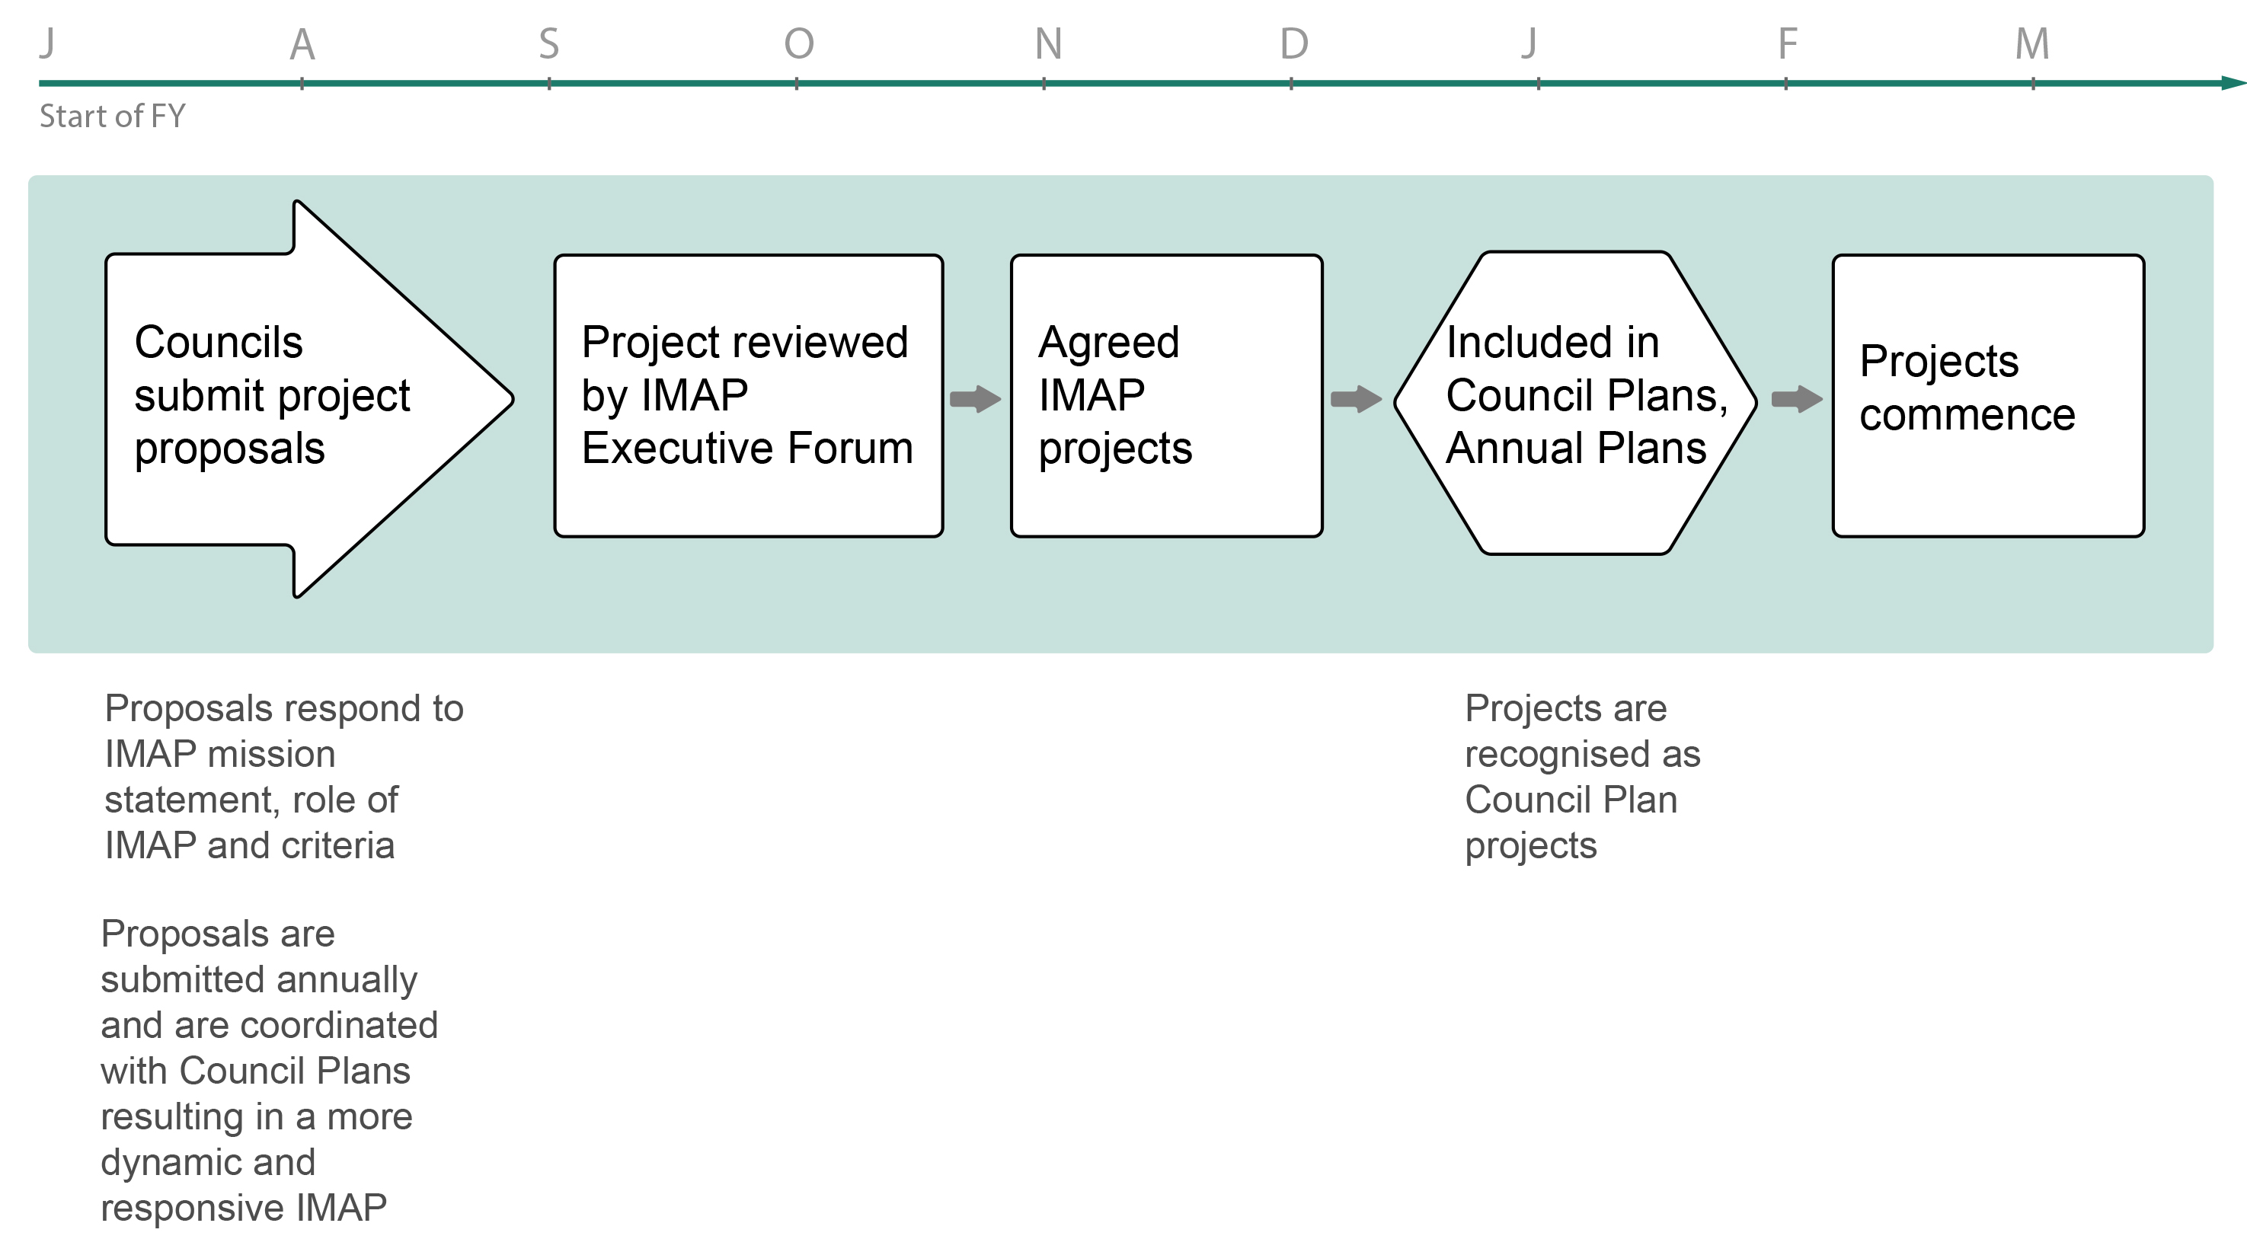
PROJECT SELECTION & IMPLEMENTATION

Slide 12
NEXT STEPS
Draft Plan available for comment in 2016
External consultation to be undertaken in Jan / Feb 2016
Preparation of Final Plan for Council approvals in April / May 2016
Contact
Elissa McElroy
IMAP Executive Officer
emcelroy@stonnington.vic.gov.au
T 9829 1110
M 0404 248 450

